Slide 1

Module 7 – Objects
What is inheritance and where do we use it
Trainer: Darko Panchevski
Assistant: Natasha Paneva

Slide 2
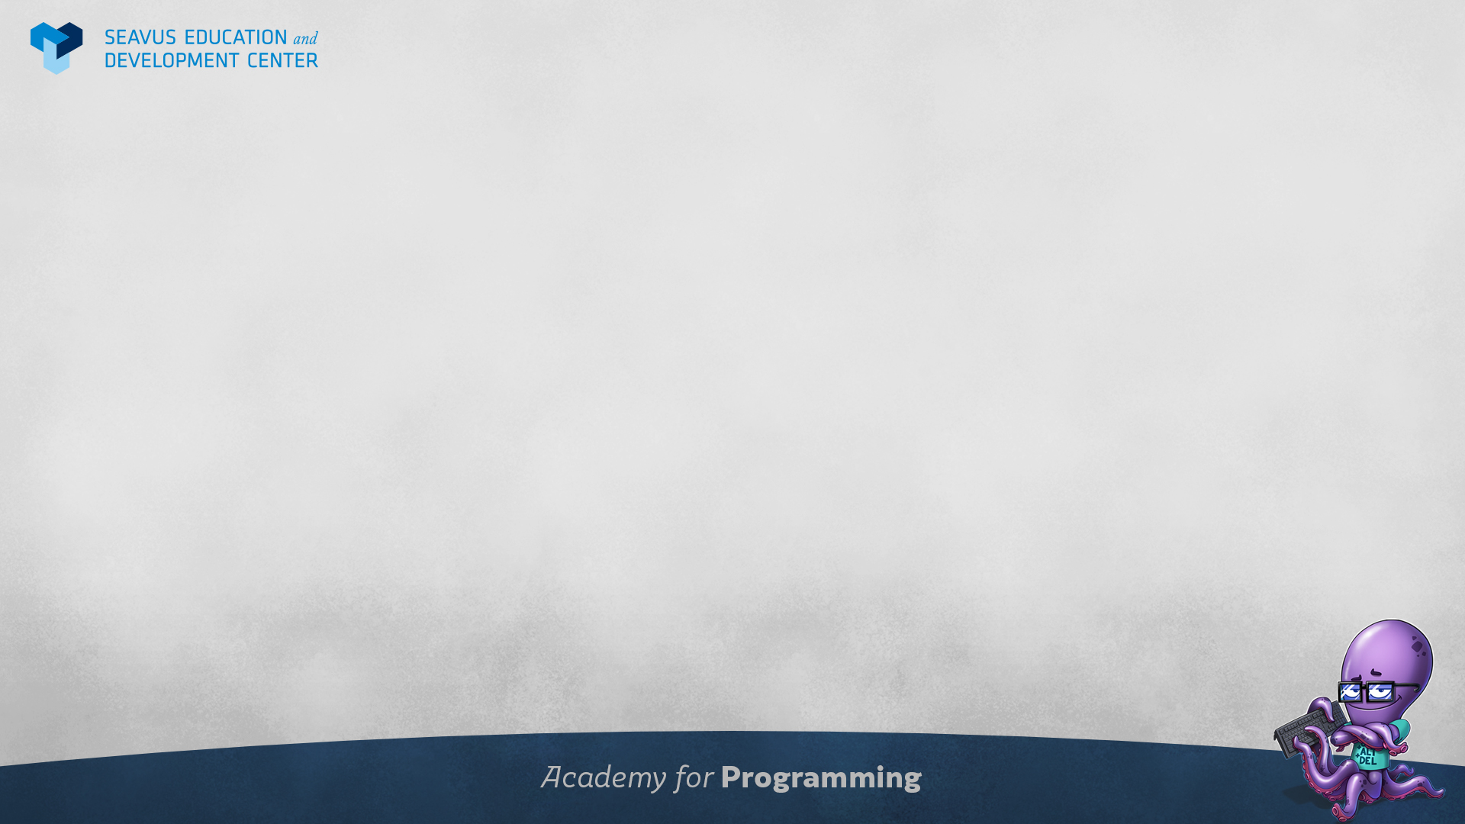
From last class
What is this in objects?
When do we use it?
What is destructing?
What is spread operator?
How can we get all the keys or values from an object?

Slide 3
Class plan
What is inheritance in OOP
Prototypal inheritance
The prototype chain
Constructor

Slide 4
What is inheritance?
One of the core concepts of OOP
It is a process of basing one object on the model of another schematic or template
JavaScript uses only objects so it has Prototypal inheritance

Slide 5
Prototypal inheritance
Unlike class based inheritance, prototypal inheritance inherit directly from objects instead of classes
When objects are inheriting they create a prototype chain
Constructor functions are usually used for inheritance in order for all the objects built from that constructor function to have the right inherited properties and methods

Slide 6

Questions?

